Slide 1
CLANG/C2 for Windows Using the VS 2015 C++ code generation (that also builds Windows, SQL, .Net, and Office)
Jim Radigan Code Gen. Technologies (CGT)
CPPCON 2015

Slide 2
Cool code generation – shipped in VS2015
Pull back and demo new CLANG based tools built on this.

Slide 3
CLANG/LLVM – Amazing community!

Slide 4

LLVM.ORG

Slide 5
Mission:
New code generation in VS2015.
Builds the entire company - C/C++
All Universal Applications in store - C#
Accrues to VS2015 retail code generation
Accrues to CLANG/LLVM based compilers, for Windows.

Slide 6
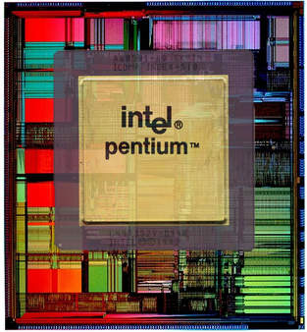
3,100,000 Transistors

Slide 7
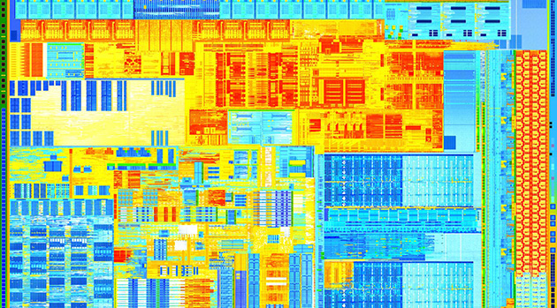
Ivy Bridge
1.4 Billion Transistors

Slide 8
Code generation is becoming more strategic and complex

Slide 9
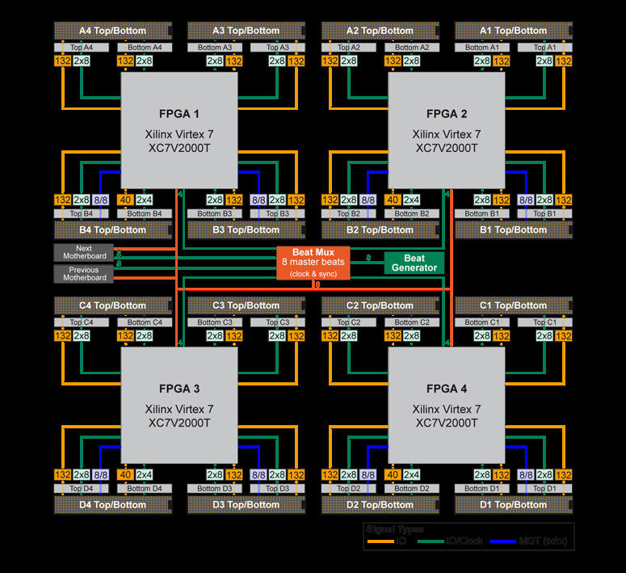
FPGA acceleration
Distributed Compute (MPI)
GPU Heterogeneous
Compute
Notes:
Tat was linear – retail code generation is becoming even more strategic for any platform

Slide 10
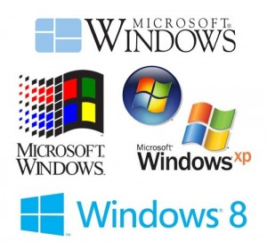
Compiler matters !
$87.7 B
1. ~Absolute Correctness
2. Compiler throughput
3. Code size
4. Code quality
$100 .0B +

Slide 11



Built with C++
Windows SQL Office
Mission critical correctness and compile time
Notes:
Financial impact to the company. The impact we have through these teams is huge
And just here, with these three teams, we’re talking about thousands and thousands of developers having access to the work we’ve done

Slide 12
How we work – team level

Slide 13
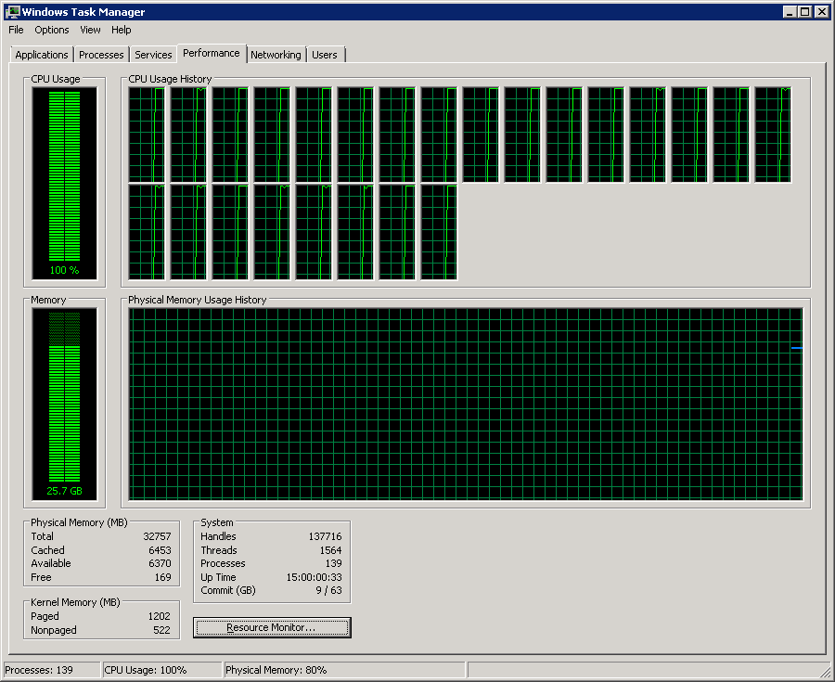
1 (of 5) Full stack Windows Builds – 6.5 hour compile

Slide 14
Within that context we shipped new
Security
Asynchronous C++ programming model
Auto vectorization
Incremental Whole Program
Build time – for the developer

Slide 15
IE Aurora Hack – Google Dangling pointer vulnerability
2. Copy evt, but fail to AddRef on CTreeNode!
<html><head><script>
var e1;
function f1(evt){
e1 = document.createEventObject(evt);
document.getElementById("sp").innerHTML = "";
window.setInterval(f2, 50);
}
function f2(){
var t = e1.srcElement;
}
</script></head>
<body>
<span id="sp">
<img src=“any.gif" onload=“f1(evt)">
</span>
</body></html>
3. Destroy img tag in span leading to free when evt falls out of scope
4. Call f2 async so evt goes out of scope
Hijack!
Vtable call via freed CTreeNode
1. Pass onload event (evt) to f1
Red is C++ called from javascript
Notes:
This is one of the most important examples because it’s the one where our current mitigations are the weakest

Slide 16
Chum – in the water
mov eax, ecx
shr eax, 9
mov eax, dword ptr [0x20000000 + eax*4]
shr ecx, 4
bt eax, ecx
jb ok_to_call
int 3

Slide 17
Instrumentation: Data structures
Bitmap to check icall
Windows modified
Loader modified
Linker and compiler paired
Small binary format changes
Binary static analysis (cracking binaries) changed
1
0
8 bytes
0
0
0
0
0
0
8 bytes
callable
memory

Slide 18
/Guard – new compiler switch
Performance – required close OS integration
Interoperation – required massive testing
Stopping zero day exploits today

Slide 19
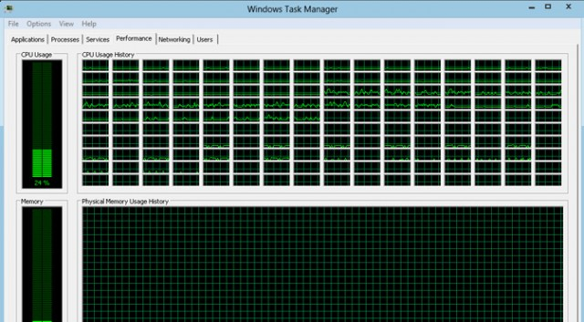
Multicore – clock rate is not increasing !

Slide 20
C++ - new asynchronous model
New MSFT C++ key words _yield and _await
True coroutines emitted from 4 code generators

Slide 21
Coroutine
generator<int> fib(int n)
{
int a = 0;
int b = 1;
while (n-- > 0)
{
yield a;
auto next = a + b;
a = b;
b = next;
}
}
int main() {
for (auto v : fib(35))
{
printf("%d\n", v);
if (v > 10)
break;
}
}

Slide 22
Execution
generator<int> fib(int n)
Suspend!!!!
RSP
auto g = fib(35)
Stack
ret-addr
g
RCX = &g (udtReturn$)
RDX = 35
slot1
savedRDI
&g
slot2
Heap
slot3
savedRSI
slot4
savedRDX
RDI = n
RSI = a
RDX = b
RBP = $fp
ret-main
savedRBP
Promise
slot1
slot2
RDI slot
slot3
slot4
saved RDI
RSI slot
saved RSI
RDX slot
saved RDX
RAX = &g
RIP slot
saved RIP

Slide 23
Efficient and Scalable
Scales to millions of concurrent coroutines
Cost of resume / suspend is comparable to that of a function call
Enables zero-overhead abstractions over existing async facilities
std::future<void> tcp_reader(int total) {
char buf[64 * 1024];
auto conn = await Tcp::Dial("127.0.0.1", 1337);
do
{
auto bytesRead = await conn.read(buf, sizeof(buf));
total -= bytesRead;
}
while (total > 0);
}
Only one memory allocation
~15 gb/s over loopback on a laptop
int main()
{
tcp_reader(1000 * 1000 * 1000).get();
}

Slide 24
C++ - Vectorizing complex control flow
for (…) {
if (cond) {
LHS1 = RHS1;
}
else {
LHS2 = RHS2;
}
}
for (i = 0; < N; i+=4…) {
mask = {cond,cond,cond,cond}
v1 = RHS1 & mask;
v2 = LHS1 & ! mask;
LHS1 = v1 | v2;
v3 = RHS2 & ! mask;
v4 = LHS2 & mask;
LHS2 = v3 | v4;
}

Slide 25
Blackscholes – vectorized
for (j=0; j<NUM_RUNS; j++) {
for (i=start; i<end; i++) {
...
if (InputX < 0.0) { // control flow1
InputX = -InputX;
sign = 1;
} else
sign = 0;
…
if (sign) { // control flow 2
OutputX = 1.0 - OutputX;
}
...
if (InputX < 0.0) { // control flow 3
InputX = -InputX;
sign = 1;
} else
sign = 0;
…
if (sign) { // control flow 4
OutputX = 1.0 - OutputX;
}
...
if (otype == 0) { // control flow 5
OptionPrice = (sptprice * NofXd1) - (FutureValueX * NofXd2);
} else {
NegNofXd1 = (1.0 - NofXd1);
NegNofXd2 = (1.0 - NofXd2);
OptionPrice = (FutureValueX * NegNofXd2) - (sptprice * NegNofXd1);
}
...
}
}
...
cmpltps xmm1, xmm2 // bit masked control flow 1
movaps xmm0, xmm2
subps xmm0, xmm3
movdqa XMMWORD PTR tv2980[esp+144], xmm1
movaps xmm4, xmm1
movaps XMMWORD PTR tv2987[esp+144], xmm0
movaps xmm0, xmm2
xorps xmm0, XMMWORD _xmm@80000000800000008000000080
andnps xmm4, xmm0
movaps xmm0, xmm1
andps xmm0, xmm2
orps xmm4, xmm0
...
pcmpeqd xmm1, xmm3 // bit masked control flow 2
movaps xmm3, xmm1
subps xmm0, xmm2
andps xmm2, xmm1
xorps xmm1, xmm1
andnps xmm3, xmm0
orps xmm3, xmm2
…
(continuing on next slide)

Slide 26
Vectorizing control flow
PARSEC\blackscholes 600% speedup on AVX2, 388% speedup on SSE2.
Numerical Recipe\ks2d1s 476% speedup on AVX2, 309% speedup on SSE2.
Geekbench_mini\sobel 231% speedup on SSE2.
Eigne\quatmul 229% speedup on SSE2

Slide 27
Scenario
#1. Developer scenario
#2. Build Lab Scenario
BUILD
DEBUG
EDIT
CLEAN BUILD
Developer does this #40 times a day
Product build nightly!

Slide 28
Build Time – At a glance

Slide 29
Incremental Whole Program (Fast LTCG)
Benchmark | VS2013 RTM | VS2015
(sec) | Incremental Whole Prog. | Incremental Whole Prog.
C2 | 129 | 13
MSHTML | 140 | 87
DXAML | 240 | 220

Slide 30
Example - edit
// WPA proves a,b,c not aliased
void foo(int * a, int * b, int * c, int count) {
for (int i = 0; i < count; i++) {
c[i] = c[i] + a[i] * b[i];
}
}
// WPA proves a,b,c not aliased
void foo(int * a, int * b, int * c, int count) {
for (int i = 0; i < count; i++) {
c[i] = a[i] * b[i];
}
}
// Imagine 100,000 other un-changed functions, 500 files
int bar() {
__declspec(align(16)) int a[128], b[128], c[128];
foo(a, b, c, 128);
// Other stuff
// ...
}
Only 1 function recompiled !!
Notes:
Not include incremental WPA Prepass

Slide 31
Incremental build - workflow
CIL
Edited
CIL
Full Build
Incremental Build
c2.dll
IPDB
c2.dll
IPDB
.obj
.obj
link.exe
link.exe
exe/dll
exe/dll
IPDB = Incremental Program Database

Slide 32
Incremental scenarios (/O2)
Benchmark | VS2013 RTM |  |  |  | VS2015
(sec) | E2E | FE | BE | Link | E2E | FE | BE | Link
Chrome (ILK) | 228.5 | 3 | 0.1 | 225 | 13.6 | 3.1 | 0.1 | 10
Chome (F) | 1023.5 | 9 | 0.5 | 1014 | 499.7 | 9.2 | 0.5 | 490
Ogre3D | 34 | 0.3 | 0.02 | 72 | 18 | 0.3 | 0.02 | 31
Epoch | ~ | ~ | ~ | 620 | ~ | ~ | ~ | 68
Auto7 | 1.08 | ~ | ~ | ~ | 1.18 | ~ | ~ | ~

Slide 33
/debug:fastlink
Linker spends a vast majority of time in creating PDB files
/debug:fastlink improves link speed (2x on average) by generating new format PDB’s.
DIA API(s) used by debugger have been modified to provide a seamless debugging experience.

Slide 34

Profile Guided Optimization (Xbox One)
Profile Guided Optimization (PGO) is now available for Xbox One titles since the June XDK 2014.
Seen bigs wins (10-20%) for many big Xbox One titles (Forza, Kinect Sports Rival, Fable Legends and more).
PGO and Forza (Xbox One)
Forza receives a 14% improvement on Game thread, and 4% gain on render thread on top of LTCG.

Slide 35

VS2015 compilers build Windows - every day!
$87.7 B
$100 .0B +

Slide 36
Code generators building Windows in the VS2015 product
Also are used to compile:
SQL
Office
.Net
Visual Studio
Windows futures

Slide 37
Code generation is responsible for:
Instruction Set Architecture
Performance
ABI
Security
Interop
Runtime semantics
Debugging
GC & AutoRefCounting
Errors and warnings

Slide 38
C/C++
Ivy Bridge
Code Generation
C2.dll
linker
binder
.EXE .DLL
1.4 Billion Transistors

Slide 39
API + ABI
C# (MSIL)
C/C++
C# version
Code Generation
C2.dll
linker
binder
.EXE .DLL
STL
BOOST
WinRT
Framework-1
.Net Native Framework
Class Library
Runtime-1
CRT140.dll
MRT100.dll
Ntdll.dll
Windows Executive Layer

Slide 40
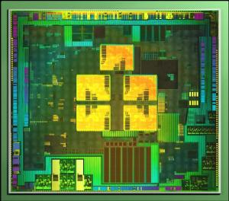
API x ABI x Hardware
USR.EXE
STL
BOOST
WinRT
Framework-1
.Net Native Framework
Class Library
Runtime-1
CRT140.dll
MRT100.dll
Ntdll.dll
ARM 32 (4 core)
Windows Executive Layer
Notes:
Its unique for each hardware target, not fully documented and it’s a moving target.
The compiler is responsible for generating code that guarantees runtime interop (yellow arrows)
Consider - GC/ARC/Unwinding the stack
WE GUARANTEE CORRECTNESS USING C2/LINKER as those are the only real specification for much of the ABI/API

Slide 41
C++: #include <vector> #include <atlbase.h> #include "MyATLObj.h" extern int bar(); void DoWork() { std::CComPtr<MyATLObj> myObj; myObj.CoCreateInstance(CLSID_MyATLOBj); int value; myObj->getValue(&value); std::vector<int> v{ bar(), bar(), value }; } void main () { __try { DoWork(); } __except(EXCEPTION_EXECUTE_HANDLER) { __fastfail(1); } } | C++/CX: #include <future> #using "MyWinRTNS.winmd" using namespace MyWinRTNS; using namespace std; using namespace std::chrono; future<int> DoWork() { MyWinRTObj ^ myObj = ref new MyWinRTObj(); return __await async([=]() { return myObj->baz()->GetResults(); }); } int bar() { try { return DoWork().get() + 5; } catch (Platform::Exception^ e) { return -1; } } | C#: using System; using System.Threading.Tasks; using Windows.Web; using Windows.Web.Http; using Windows.Foundation; namespace MyWinRTNS { public interface IMyWinRTObj { IAsyncOperation<int> baz(); } public sealed class MyWinRTObj : IMyWinRTObj { private async Task<int> DoWork() { HttpClient client = new HttpClient(); try { string str = await client.GetStringAsync( new Uri("http://msdn.microsoft.com")); return str.Length; } catch (Exception e) { if (WebError.GetStatus(e.HResult) == WebErrorStatus.BadGateway) { return -1; } throw e; } } public IAsyncOperation<int> baz() { return DoWork().AsAsyncOperation<int>(); } } }
Notes:
c++ calls bar c++/cxx calls its own DoWork its DoWork calls c#'s baz c#'s baz calls its own DoWork which calls into WinRT for http stuff

Slide 42
C/C++
C/C++
.exe
.exe
ARM 32
X64
C/C++
C/C++
.exe
.exe
x86
new - fall
Notes:
Different on each hardware target:
- Unwinding an exception,
debugging,
marshalling data,
serializing objects,
calling conventions etc.
COM interop
Etc.

Slide 43



Top Down - C++ broad cross platform
Windows
iOS
Android
C#, CX
ObjC, Swift
Java
---------- C++
---------- C++ CLANG
---------- C++
CLANG

Slide 44

clang AST -> LLVM IR -> c2.dll tuples

Slide 45
X64
ARM 32
x86
new - fall
Notes:
Different on each hardware target:
- Unwinding an exception,
debugging,
marshalling data,
serializing objects,
calling conventions etc.
COM interop
Etc.

Slide 46
Clang/C2 - for C++ and 4 MSFT ABI(s)
C++ tests:
99% internal C++ tests across 4 architectures
/O2 - fully optimized
/Od – full debug support
Many large applications

Slide 47
V1 in Nov: Many local changes
Debug info, structured exception handling, 3 lines for the bridge
Contributing all back to the community
V2 February: Virtually no local changes (~3 lines local)

Slide 48
1.) …\clang\tools\driver\driver.cpp: //load c2.dll, CLANG obj
→ fn_utc_cc1_main(argv.slice(2), argv[0], GetExecutablePathVP);
2.) …\clang\tools\driver\cc1_main.cpp: // c2 initialize
→ fn_UTCExecuteCompilerInvocation(Clang.get())
3.) …\clang\lib\CodeGen\CodeGenAction.cpp //llvm to utc
→ ClangInvokeCompilerPassW(this)
Notes:
1) Early initialization of clang/c2
2) Initialization of c2
3) c2 entry point
CLANG object is C++ layout – needs to be identical in C2 and CLANG therefore, call into UTC to create the object
Dynamically load c2.dll
I don't think people will care that clang.exe calls into c2.dll to create a Clang object, which is passed back into clang.exe. The point is that C2 views CLANG/LLVM as read only and with 3 line of change there’s no fork and besides the community would never test our path if we were to contribute these changes back

Slide 49
While helping CLANG/LLVM on Windows
CLANG
CLANG
CLANG
LLVM
LLVM
LLVM
UTC
UTC
UTC

Slide 50
LLVM Bitcode – universal input to Windows ABI
CLANG
Compilers
Tools
LLVM
LLVM bit code
UTC

Slide 51
We will not fork.
Will help the CLANG/LLVM compiler onto Windows.
CLANG/C2 is read only and 3 lines of change.
Zero changes will be proposed for CLANG/LLVM unique to C2.dll

Slide 52
C++ Universal cross platform
#ifdef (specific_compiler_implementation)

Slide 54
#ifdef – Deal with “implementations”
Missing C++ standards conformance
Errors and warning
Bugs
Libraries
Notes:
Note that most people want to treat warnings as errors in their builds

Slide 55
Now Compiles - #ifdef (conformance)
Variable Templates struct limits { template<typename T> static const T min; }; template<typename T> const T limits::min = { }; | Non Static Data Member Initializations for aggregates struct S { int a; const char* b; int c; int d = 0; }; S ss = { 1, "asdf" }; | Nested namespace namespace A::B::C { //… }

Slide 56
Goes away
//do not warn for library files
#ifndef _MSC_VER
#pragma GCC diagnostic push
#pragma GCC diagnostic ignored "-Wall“
#endif

Slide 57
Goes away
#ifdef _MSC_VER
#pragma warning( disable : 4127 ) // warning C4127: conditional expression is constant
#endif
while ( true ) // This loop traverses the tree to find a spot for insertion

Slide 58
Goes away
#ifdef _MSC_VER
#pragma warning( push )
#endif
...
#ifdef _MSC_VER
#pragma warning( pop )
#endif

Slide 59
Goes away – template bug work around
template <typename T> void print(T t) { cout << "Unknown: " << t << endl; }
void print(long long n) { cout << "long long: " << n << endl; }
void print(unsigned long n) { cout << "unsigned long: " << n << endl; }
void print(unsigned long long n) { cout << "unsigned long long: " << n << endl; }
int main() {
cout << "\nThis should be 4 billion, long long, negated by unary minus to negative 4 billion, long long.\n";
#if defined(_MSC_VER)
print(-(long long)4000000000);
#else
print(-4000000000);
#endif
}

Slide 60
Quick (Friday) Measurements

Slide 61
C
Spec2k6\gcc /O2 | Overall | Front-end | Back-End
c1/c2 | 28s | 7.8s | 20.0s
clang/c2 | 38s | 13.4s | 24.3s
C
C++ no templates
Spec2k6\xalancbmk Single biggest file /O2 | Overall | Front-end | Back-End
c1/c2 | 2.65s | 1.5s | 1.14s
clang/c2 | 2.67s | 1.4s | 1.24s
C++ <templates>s
Eigen\benchmarks.cpp (heavy templates) /O2 | Overall | Front-end | Back-End
c1/c2 | 16.8s | 3.1s | 13.8s
clang/c2 | 17.0s | 2.7s | 14.3s

Slide 62
C → C++ → C++<templates>
Compile time continuum

Slide 63
LLVM-C2 Bridge – VTune profiles show < 1% Vtune shows this on par with Bit Copy in the compiler

Slide 64
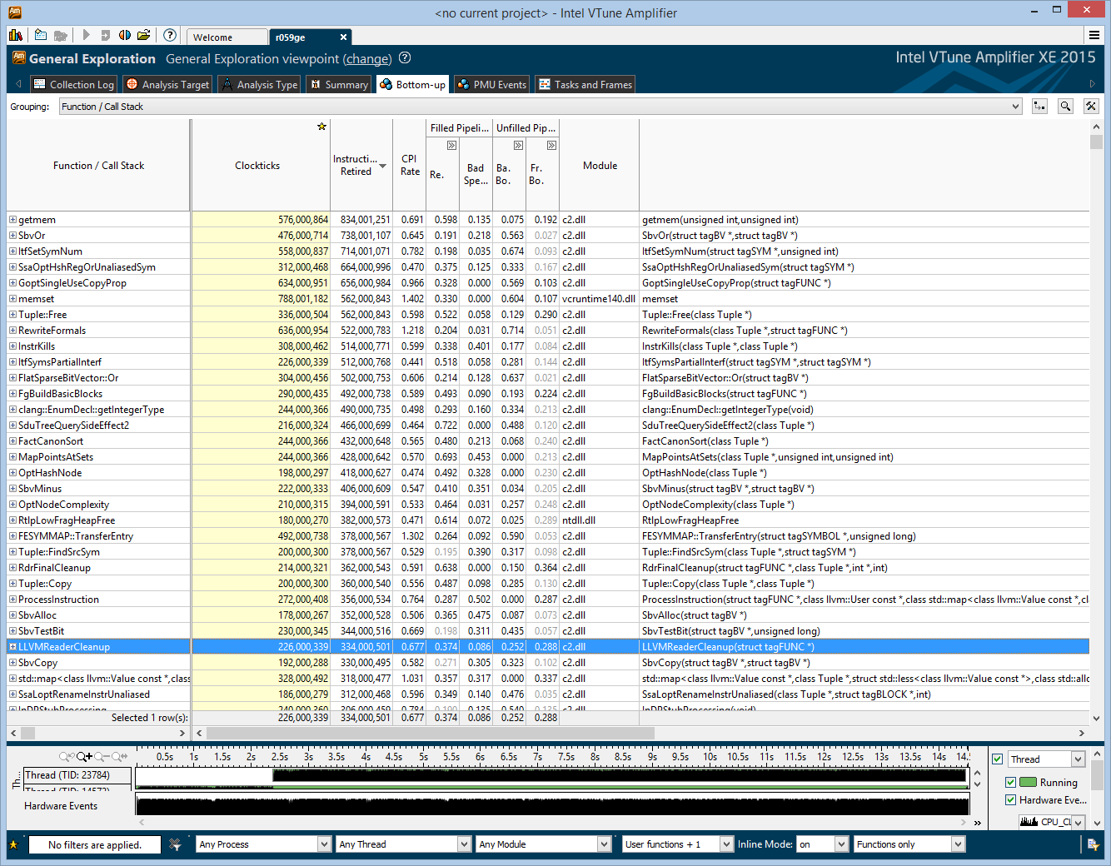

Slide 65
c1/c2 built with /O2 /fp:fast
clang/c2 built with /O2 -Xclang -ffast-math
Benchmark | c1/c2 faster by
bzip2 | 7%
mcf | -4%
milc | 7%
namd | 4%
gobmk | 5%
soplex | 13%
povray | 8%
hmmer | 52%
sjeng | 4%
libquantum | 13%
h264ref | 9%
lbm | 1%
omnetpp | 2%
sphinx3 | 3%

Slide 66
Integer vectorization - full rewriting to determine vectorization, with undo 90% functional
void test16(int *x, int *a, int *b) {
while (a < b) *a++ += 2 + *x++; }

Slide 67
4 Demos
C99 – 1000+ up votes user voice
Full Structured Exception Handling
Bing Maps – Jason library
iOS Objective-C on Windows

Slide 68
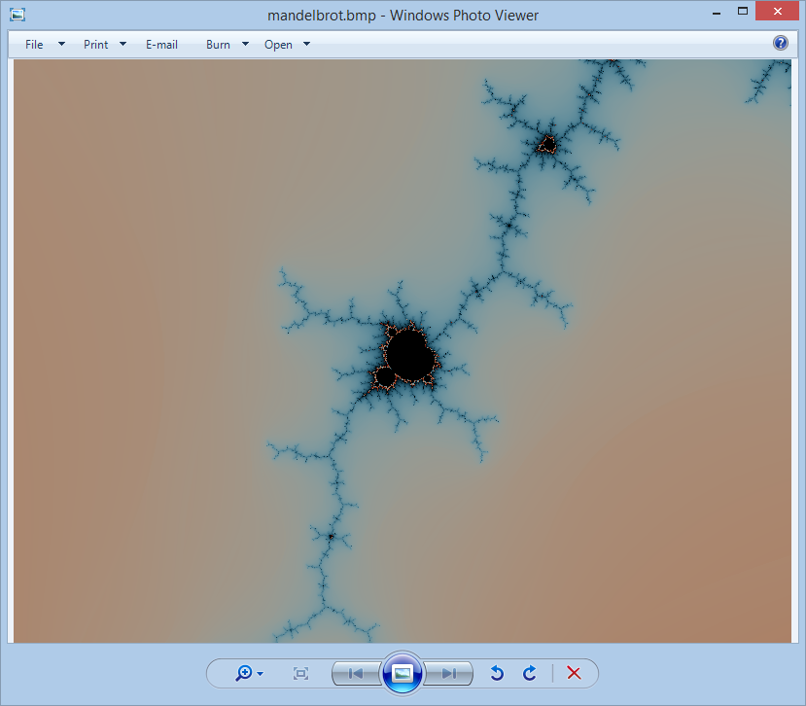
Show Full C99
Top ask on user voice!

Slide 69
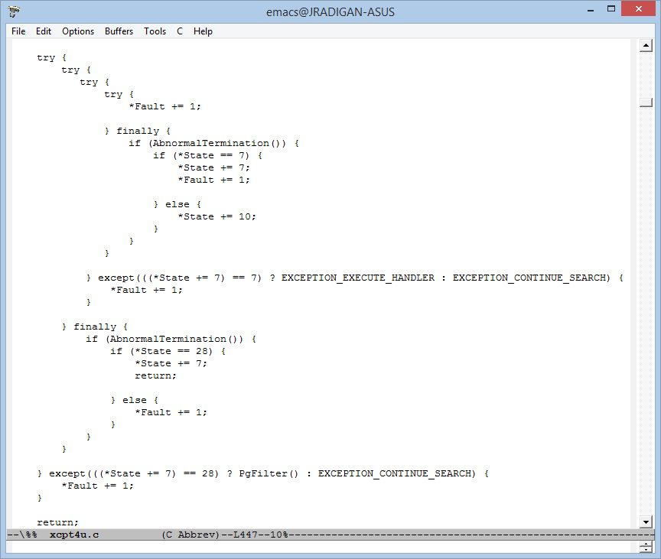
Structured Exceptions
Fully Supported

Slide 70
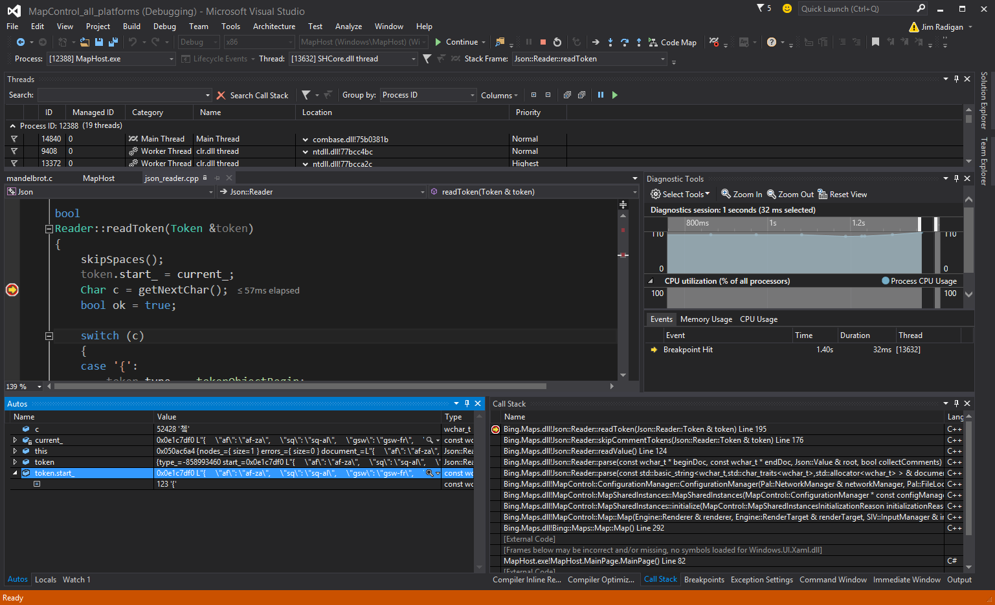
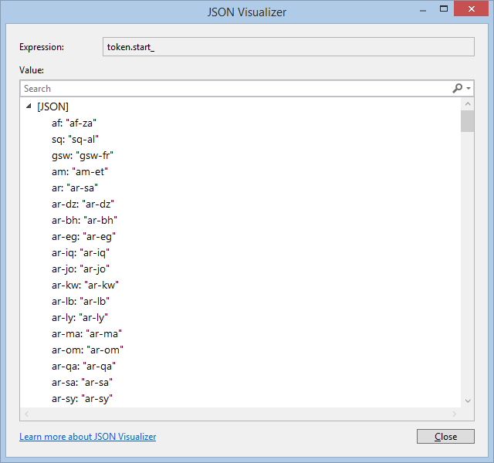

Slide 71
